Slide 1
Navigating the dei landscape under the new administration
David Glasgow
Executive Director, Meltzer Center for Diversity, Inclusion, and Belonging
Adjunct Professor of Law
NYU School of Law
February 3, 2025

Slide 2
Early actions of the trump administration

Slide 3
What dei-related actions has the trump administration taken so far?
Rescinded DEI-related executive orders by President Biden
Appointed Andrea Lucas as Acting Chair of the EEOC (who has announced she will prioritize “rooting out unlawful DEI-motivated race and sex discrimination”), and purported to remove other EEOC commissioners
Issued executive orders targeting ”gender ideology,” DEI in the federal government and military, and “illegal discrimination”

Slide 4
Executive order on “ending illegal discrimination”
Various DEI-related executive orders are revoked, including Executive Order 11246, which required equal opportunity and nondiscrimination in government contracting
The Office of Federal Contract Compliance must cease promoting diversity and holding contractors responsible for taking “affirmative action”
Every government contract or grant award will include a term requiring the recipient ”to certify that it does not operate any programs promoting DEI that violate any applicable Federal anti-discrimination laws”
The Attorney General shall submit recommendations on how to “encourage the private sector to end illegal discrimination and preferences, including DEI,” such as through civil compliance investigations and litigation

Slide 5
Implications for private employers
These executive orders do not require private employers—even those that contract with the federal government—to abandon or alter their own DEI programs
Organizations that allow workers to align pronouns and other identity markers to their gender identity, or that allow workers to use bathrooms that align with their gender identity, may continue to do so
Organizations that contract with the federal government will no longer be required to comply with Executive Order 11246 but must still comply with federal anti-discrimination laws
This administration will prioritize enforcement action against pro-DEI organizations, underscoring the need to do a thorough DEI self-audit
More action will occur—look out for Attorney General guidance and/or more executive orders

Slide 6
Three models for advancing dei
When in Rome
Comply with the law, but make sure to know what the law is, and do not over-comply
Embassy
Create the most diverse, equitable, and inclusive internal culture that you can for your own employees
Advocate
Use your voice to advocate for DEI and push back on anti-DEI attacks

Slide 7
Dei communication

Slide 8
Companies that have announced changes to their dei strategy

Slide 9
Companies that have reaffirmed commitment to dei

Slide 10
Communications risks
Statements that suggest the organization confers preferences on protected groups with respect to palpable benefits (the three Ps)
Statements that create a “hostile work environment” for protected groups

Slide 11
What makes a program RISKY: the ”three ps”
Conferring preferences
On protected groups
With respect to PALPABLE benefits

Slide 12
Justification for dei
Risky statement | Why it’s risky | Improved statements
“DEI uplifts historically disadvantaged groups to ensure equal outcomes.” | The reference to equal outcomes could suggest some groups get preferential treatment to reach a predetermined goal. A better statement would: Focus on removing bias; or Justify DEI as beneficial for everyone | “DEI removes unfair barriers that prevent disadvantaged groups from competing on a level playing field.” “Talent is everywhere but opportunity is not; DEI closes the gap.” “DEI enables people of all identities and backgrounds to feel welcome and do their best work.” “DEI seeks to eliminate the biases that affect marginalized groups in the workplace.”

Slide 13
Hiring and promotion
Risky statement | Why it’s risky | Improved statements
“We use diversity hiring to recruit people from underrepresented racial and ethnic backgrounds.” | This statement could suggest the organization considers race or ethnicity in employment decisions. | “We conduct outreach at diverse colleges to strive for a diverse applicant pool.” “While we strive for a diverse mix of candidates, all employment decisions are made without regard to race, sex, or other protected characteristics.” “We look for candidates of any background who will advance our culture of diversity, equity, and inclusion.”

Slide 14
Data collection
Risky statement | Why it’s risky | Improved statements
“We collect demographic data to achieve racial and gender balance in our promotion decisions.” | This statement could suggest the organization considers race and sex in employment decisions. Better statements would cite lawful reasons for collecting data, such as monitoring differential impacts of programs or debiasing systems. | “We collect demographic data to identify and address the implicit bias that research suggests we all have as human beings.” “We collect demographic data to monitor how our programs affect members of different groups within our organization.”

Slide 15
Diversity training
Risky statement | Why it’s risky | Improved statements
“Racism is in white people’s DNA.” | This statement makes a negative and stereotypical claim about a group of people defined by a protected characteristic (race). It is lawful to discuss racism, racial bias, and even concepts that some participants might find provocative such as white supremacy, provided that no demographic group is singled out with broad negative claims. | “Systemic racism has caused racial disparities in education and employment opportunities.” “Research suggests that implicit racial bias is widespread.”

Slide 16
Diversity targets
Risky statement | Why it’s risky | Improved statements
“We will increase our percentage of women leaders by 30% over the next five years to ensure our leadership reflects the demographics of our society.” | This statement could suggest the organization considers a protected characteristic (sex) when making employment decisions to reach a desired outcome. Better statements would use aspirational, non-binding language (such as “aim,” “aspire,” or “strive”) rather than rigid language (such as “will,” “ensure,” or “require”). | “We aspire to increase our percentage of women leaders by 30% over the next five years.” “While we aim to increase our percentage of women leaders across the organization as a whole, all employment decisions are based on the qualifications and skills of the candidates.”

Slide 17
Leader accountability
Risky statement | Why it’s risky | Improved statements
“We hold leaders accountable by offering larger bonuses to those who successfully implement our diversity target.” | This statement could suggest that leaders have a financial incentive to consider protected characteristics in employment decisions. Better statements tie accountability to other DEI measures, such as inclusive leadership. | “We hold leaders accountable by assessing their inclusive leadership capabilities as part of our annual review process.” “We require all leaders in our organization to demonstrate that they have taken tangible steps to advance our values of DEI, such as by conducting campus outreach, mentoring junior talent, or participating in affinity group activities.”

Slide 18
Supplier diversity
Risky statement | Why it’s risky | Improved statements
“At least 40% of our vendors will be businesses owned by an underrepresented racial group.” | This statement could suggest that some vendors may be granted or denied a contract based on race, which would violate federal law. | “Our supplier diversity program ensures that minority- and women-owned businesses have an equal opportunity to be selected as a vendor.” “We conduct outreach and extend support to a diverse range of vendors, including minority-owned, women-owned, veteran-owned, and LGBTQ-owned businesses, to ensure we are actively considering the best suppliers for our business.”

Slide 19
what does not involve inherent legal risk
The acronym “DEI”
The term “equity”
References to striving for demographic diversity

Slide 20
recommendations
Align internal stakeholders
Document the organization’s approach to DEI in writing
Train leaders on how to communicate around DEI

Slide 21
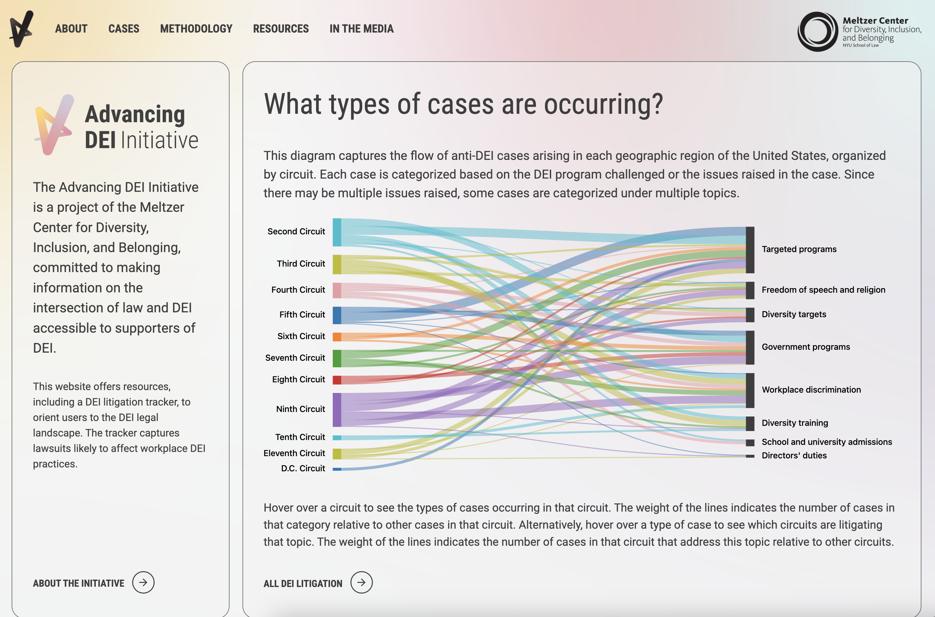
Advancing dei initiative
advancingdei.meltzercenter.org
The Advancing DEI Initiative aims to make information on the intersection of law and DEI accessible to supporters of DEI, including through resources and a DEI litigation tracker.

Slide 22
Q&A

